Slide 1

COMP396
DESIGN PRESENTATION
Speaker: Team 02
Wong Haw (S2 & S4 Designer)
Zhang Ao (S1 Designer)
Xue Yudan (S3 Designer)
Zhao Yixuan (Leader & Coder)
Notes:
Hi, this is team 02, In this presentation we will introduce our trading strategy design for data 1.

Slide 2
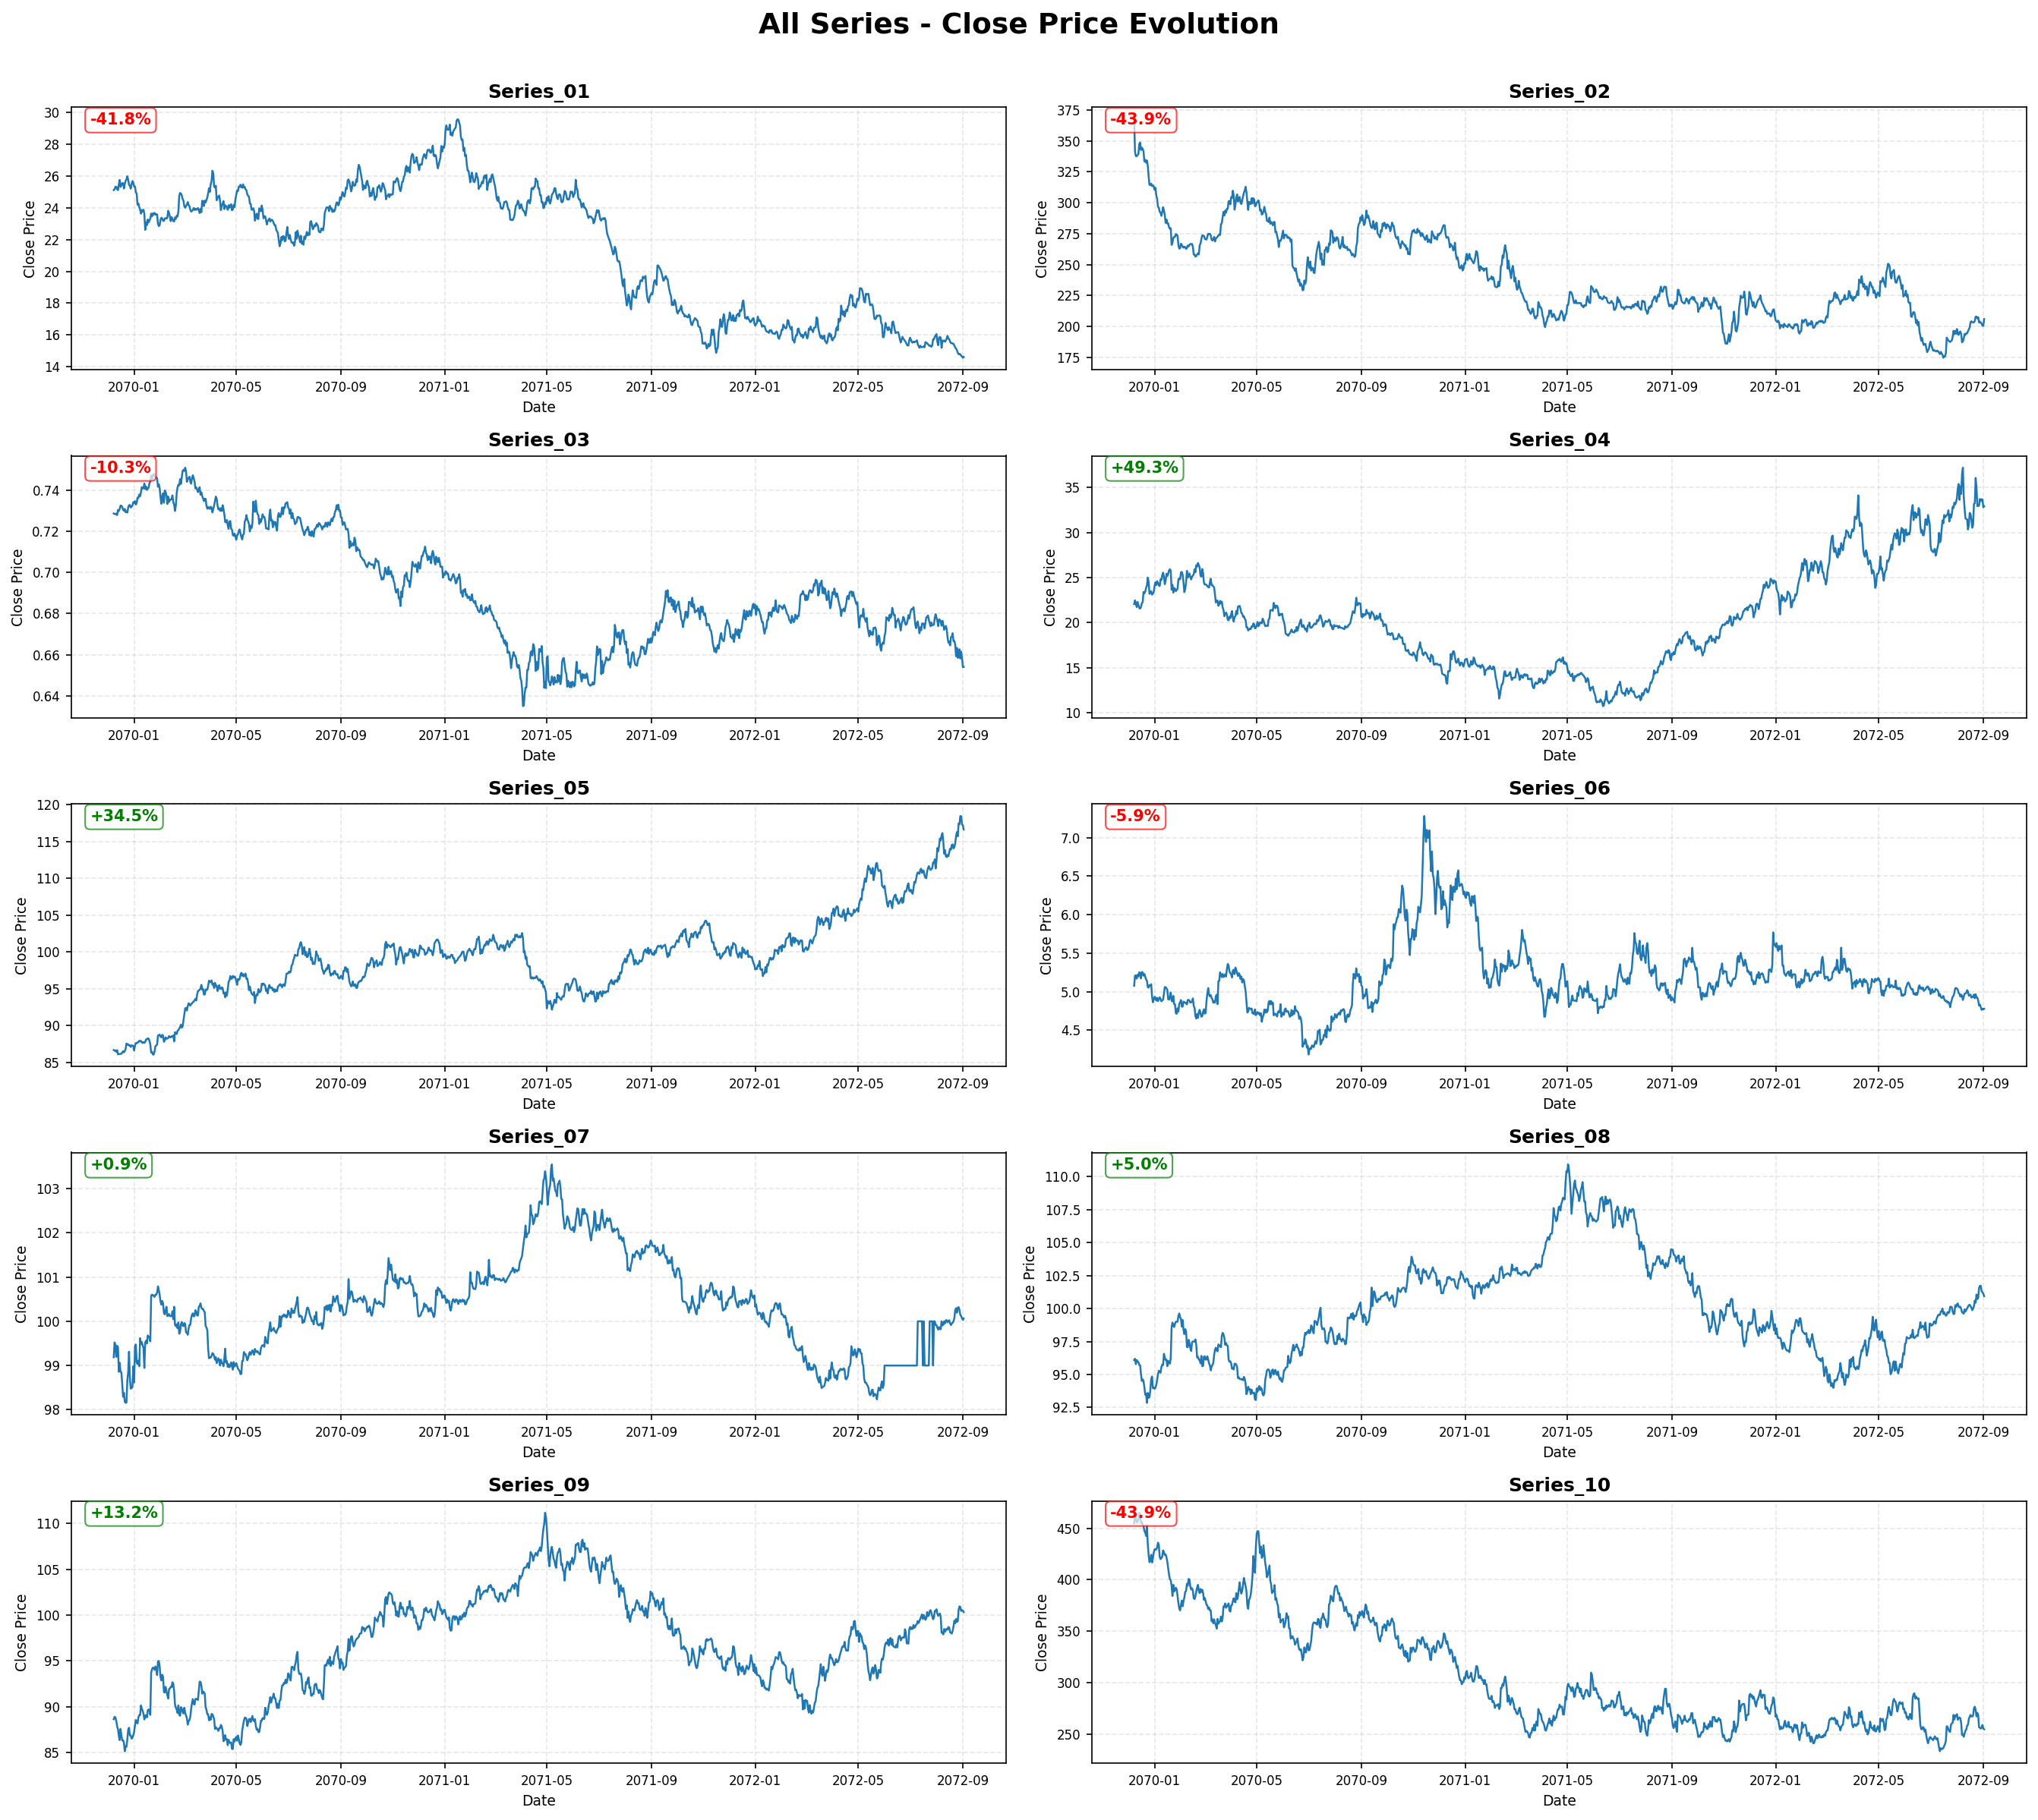
Strategy Selection
Wong Haw
Observed Characteristics:
Series 01-03: Mixed trending and ranging behavior with moderate volatility
Series 04: Clear alternating trends with balanced upward/downward movements - suitable for trend-following strategies
Series 05: Strong sustained uptrend with minimal drawdowns - ideal for buy-and-hold approach
Series 06-08: High volatility with irregular patterns, challenging for systematic strategies
Series 09: Range-bound oscillation around a stable mean - characteristic of mean-reverting behavior
Series 10: Irregular price action with abrupt movements
Final Decision:
Series 04: Dual Moving Average Strategy
Series 05: Buy and Hold Strategy
Series 09: Mean-Reversion Strategy
Notes:
Asset Selection Rationale:
This is the data and pricing moving we found out for each series over 1000 days.
Based on the visual analysis, three assets were selected for strategy development:
⚫ Series 04: Dual Moving Average Strategy
Reason: Series4 demonstrates clear trend phases, regular crossover opportunities and balanced directional movements.
⚫ Series 05: Buy and Hold Strategy
Reason: It shows a sustained long-term upward trend, has good risk-return characteristics.
⚫ Series 09: Mean-Reversion Strategy
Reason: It shows stable fluctuation range near the average price level.

Slide 3
Zhang Ao
Content
Strategy 1:
Dual Moving Average
Strategy Definition
Data Analysis
Technical Specification
Preliminary Testing & Optimization
Plan (Future enhancement)
Series 04 – Trend-Following Strategy
Notes:
Hello everyone, I will be presenting Strategy 1: the Dual Moving Average Crossover, designed for Series 04, which shows strong trend-following behaviour. This part covers 5 components.

Slide 4
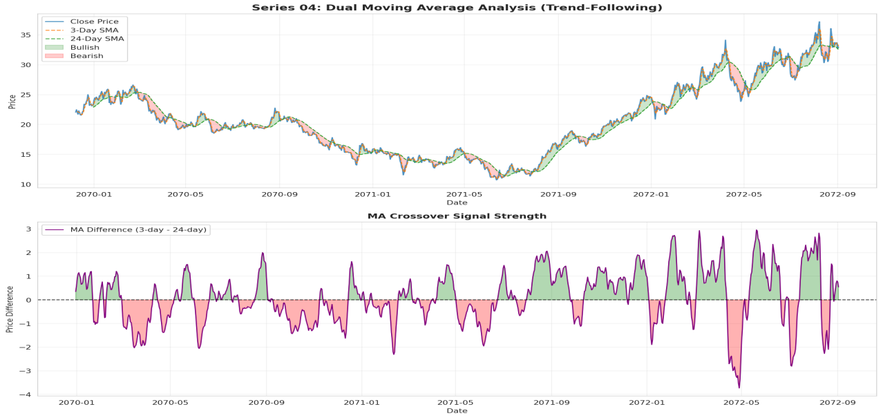
Strategy Type Definition
Zhang Ao
Figure 1.1: Series 04 price evolution with 3-day and 24-day SMAs showing trend identification
Trend-following strategy based on the momentum effect
Uses 3-day fast MA & 24-day slow MA
Captures breakouts after consolidation
Decisions based on daily closing price
Flexible holding period depending on trend strength
Notes:
Strategy 1 is a momentum-based trend-following system using a 3-day fast MA and a 24-day slow MA to detect short-term trend shifts. A Golden Cross indicates entry, and all signals are based on daily closing prices. The holding period naturally adjusts to trend strength, making the strategy simple, consistent, and highly interpretable.

Slide 5
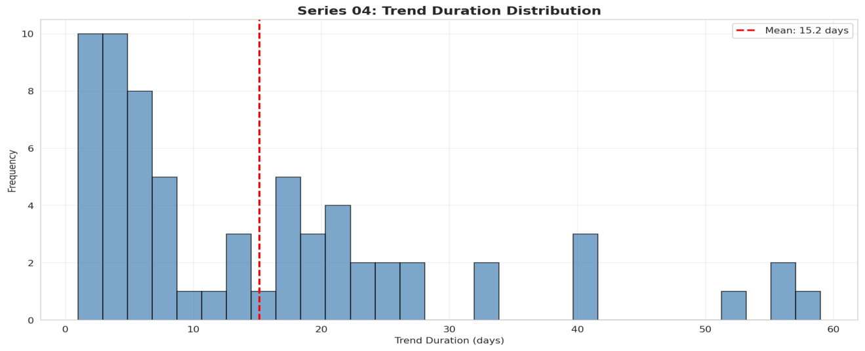
Data Analysis
Zhang Ao
Clear alternating trend phases
65 crossover signals about 15 per year
Updated VS downtrend days almost 50/50
no directional bias
Avg trend duration: 15.2 days
Longest trend: 59 days
Low whipsaws strong fit for dual-MA systems
Figure 1.1: Series 04 price evolution with 3-day and 24-day SMAs showing trend identification
Figure 1.2: Distribution of trend durations in Series 04
Series 04 provides stable, predictable trend structures ideal for MA crossovers.
Notes:
Before designing the strategy, we examined the characteristics of Series 04. It displays very clear alternating trend phases and generates 65 crossover signals, about 15 per year, meaning signal frequency is stable. Uptrend and downtrend days are almost 50/50, showing no strong directional bias. The average trend duration is 15.2 days, and the longest trend reaches 59 days, which is long enough for moving averages to capture meaningful momentum. The trends are relatively smooth with moderate volatility and limited whipsaw noise, making Series 04 a strong fit for a dual-MA approach.

Slide 6
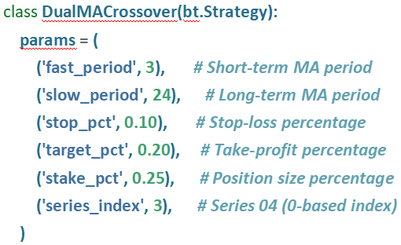
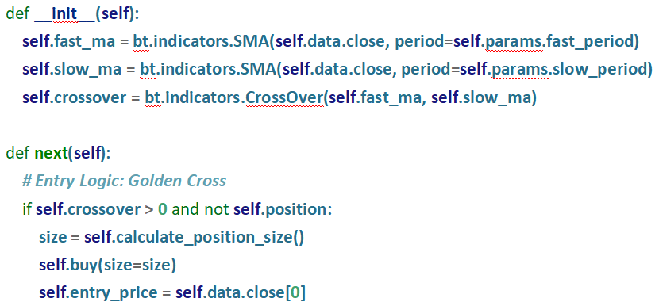
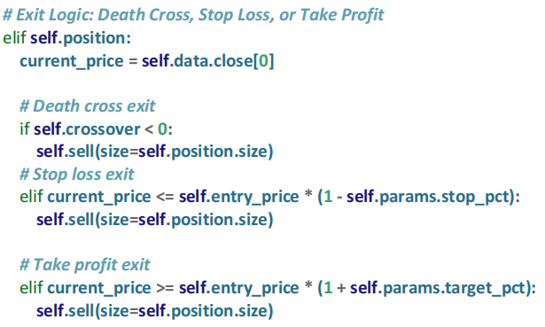
Technical Specification
Zhang Ao
Trading Logic Summary
Entry condition:
Fast MA crosses above Slow MA (Golden Cross)
No existing position
Exit conditions:
Death Cross
10% Stop-loss
20% Take-profit
Position sizing:
25% of allocated capital per trade
Design purpose: Simple, interpretable, and robust trend-following implementation.
Notes:
We uses five main parameters:
a 3-day fast MA, a 24-day slow MA, a 10% stop-loss, a 20% take-profit, and a 25% position size.
The entry rule is simple — we only enter when the fast MA crosses above the slow MA and no position is open.
For exits, the strategy closes the position in three situations: a Death Cross, hitting the stop-loss, or hitting the take-profit. Overall, this design keeps the strategy very clean and robust, balancing trend capture with clear risk management.

Slide 7
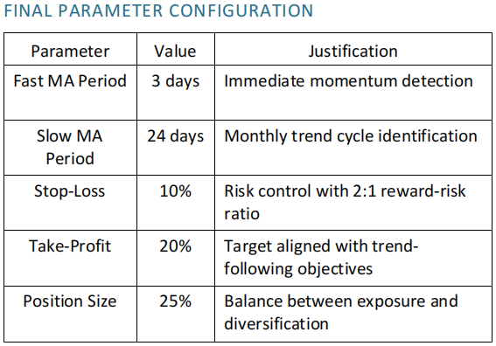
Preliminary Testing & Optimization
Optimization – Train/Test Spilt & Grid Search
Zhang Ao
Grid Search across：
Fast MA: 3-15
Slow MA: 20-50
SL: 5-15%
TP: 15%-30%
Size: 20-30%
Optimization targets:
Sharpe Ratio (primary)
Max Drawdown
Win Rate
Parameter stability
Overfitting prevention:
Strict data separation
Multi-window robustness checks
Notes:
To avoid overfitting, we used a 70/30 chronological split. We performed a Grid Search across fast MA, slow MA, stop-loss, take-profit, and position size. Sharpe ratio was used as the main optimization metric, while maximum drawdown, win rate, and parameter stability were also evaluated. The selected configuration—3, 24, 10%, 20%, and 25%—showed consistent performance across multiple windows, which is essential for out-of-sample generalization.

Slide 8
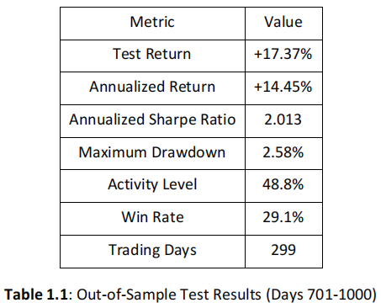
Out-of-Sample Results
Zhang Ao
Sharpe Ratio = 2.013
→ Excellent risk-adjusted performance on unseen data.
Maximum Drawdown = 2.58%
→ Strong downside protection; stable equity curve.
Test Return = +17.37%
→ Strong profitability over the OOS period.
Activity Level = 48.8%
→ Strategy avoids overtrading; trades only when trends exist.
Win Rate = 29.1%
→ Typical of momentum/trend-following systems:
A few big winners dominate overall profitability.
Annualized Return = 14.45%
→ Consistent with trend-following characteristics.
Excellent OOS generalization — strong confirmation of strategy validity.
Notes:
Overall, the strategy performs really well on unseen data.
We get a Sharpe ratio of about 2, and the maximum drawdown stays below 3%, which means the risk is very well controlled.
The total return is roughly +17%, and the activity level is around 49%, so the strategy only trades when there’s a clear trend instead of trading all the time.
The win rate is about 29%, which is completely normal for trend-following strategies, where a few big winners generate most of the profits.
And the annualised return is around 14%, which matches the characteristics of this type of model.
Overall, the strategy shows very strong generalisation in the out-of-sample period.

Slide 9
Zhang Ao
Why improve S1?
Whipsaw risk in sideways markets
Enhancement
Add ADX > 20-25 trend-strength filter
Expected Benefits
Fewer false signals
Higher stability
Better win rate
Next Step
Re-optimize ADX threshold on Data 2
Plan
Future Enhancement
— ADX Trend Filter
Notes:
Dual-MA systems struggle in sideways markets due to whipsaw effects. To address this, we plan to add an ADX trend-strength filter, trading only when ADX exceeds 20–25. This is expected to reduce false breakouts, improve stability, and increase win rate. The enhanced version will be tested and re-optimized using Data 2 in the next stage.

Slide 10
Wong Haw
Content
Strategy Definition
Data Analysis
Asset Selection Methodology
Technical Implementation
Out-of-Sample Performance
Future Development
Strategy 2:
Buy And Hold
Series 05
Notes:
English Title: Uppercase, Calibri size 60, XJTLU Navy
English Subtitle: Uppercase, Calibri size 36, XJTLU Navy

Slide 11



Wong Haw
Strategy Definition
– Passive Trend-Following –
– Core Philosophy –
This strategy employs a passive methodology optimized for assets demonstrating sustained upward trends. It operates on a pure "set and forget" principle, executing a single entry at the initiation of the trading period.
The approach builds upon the Efficient Market Hypothesis and the long-term equity premium principle. It aims to capture the inherent positive drift of high-quality assets without the friction of frequent trading.

Slide 12
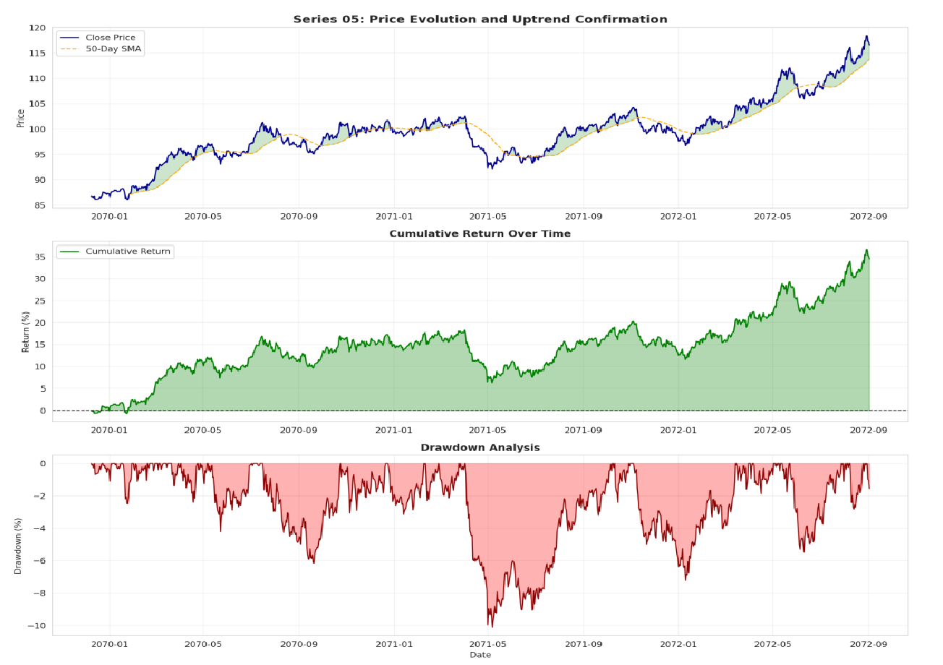
Wong Haw
Data Analysis
Total Return: 34.53% over 1000 days.
Consistency: Price traded above the 50-day SMA for 63.10% of the period.
Positive Drift: 54.63% of trading days closed positively.
Risk Profile: Max drawdown limited to 10.13%, yielding a strong 3.4:1 return-to-drawdown ratio.

Slide 13
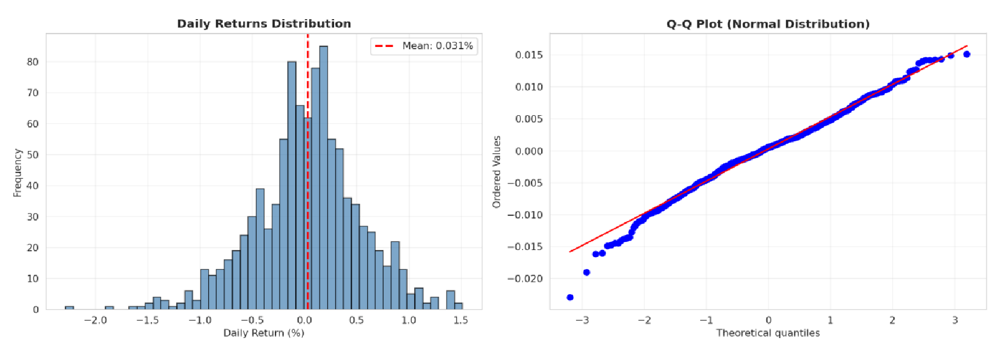

Wong Haw
Asset Selection Methodology
Daily returns = 0.031%
Volatility = 0.505%
Creating an ideal environment for passive strategies where positive drift compounds with minimal noise.

Slide 14
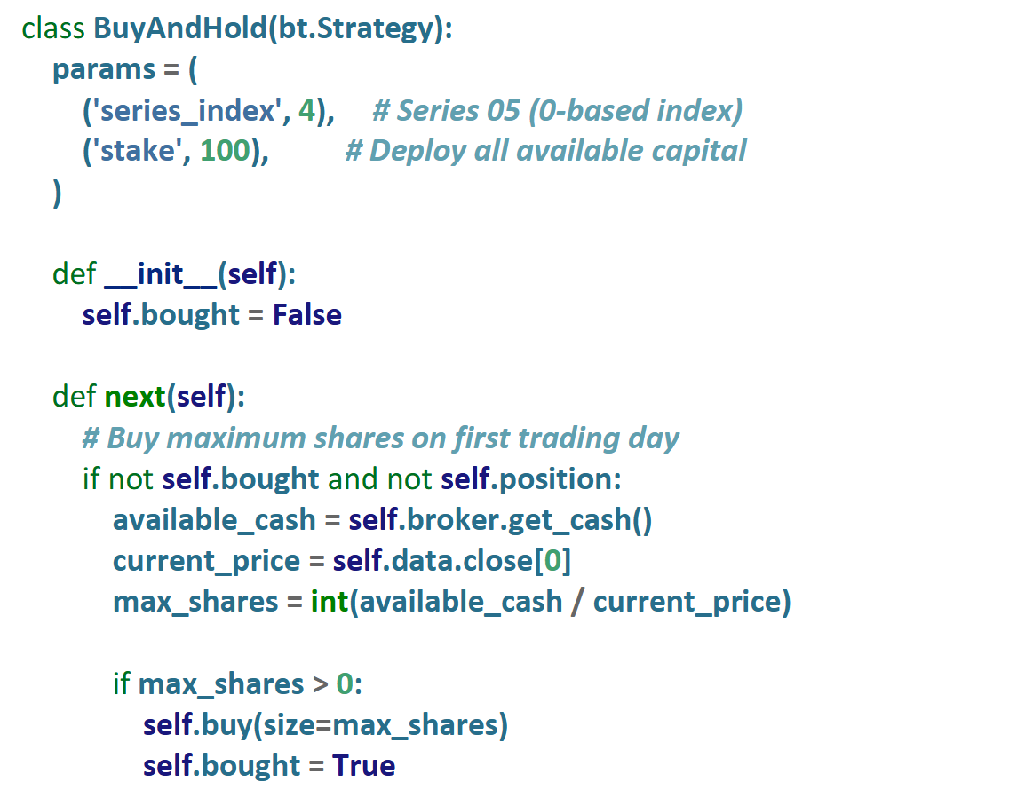

Wong Haw
Technical Implementation
Breakdown of code:
– A single entry on the first trading day deploying maximum available capital
- Holds the position until strategy termination with no intermediate exit decisions.

Slide 15
Wong Haw
Out-of-Sample Performance
Metric | Value
Test Return | 14.31%
Annualized Return | 11.93%
Annualized Sharpe Ratio | 1.335
Maximum Drawdown | 5.82%
Activity Level | 99.0%
Win Rate | 54.5%
Trading Days | 299 Days
Overall performance is solid for a pure Buy & Hold:
Annualized Return 11.93% is a strong outcome for a passive equity exposure over the sample period and implies consistent compound growth.
Sharpe Ratio 1.335 indicates the strategy delivered excess return per unit of volatility at a level investors commonly view as attractive for long‑only approaches.
Maximum Drawdown 5.82% is relatively shallow, meaning the worst historical loss was limited compared with many equity cycles. This reduces the emotional and capital stress of staying invested.
Note: Win rate alone is misleading. A strategy can have a modest win rate but large winners that drive overall returns, or a high win rate with small gains and occasional large losses

Slide 16
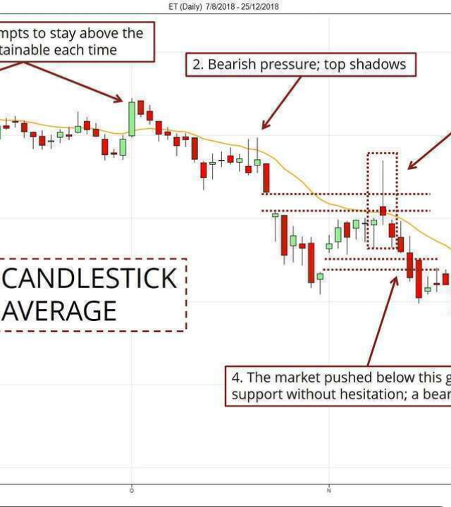
Wong Haw
Future Development
Addressing Limitations
The primary weakness is the lack of active risk management during bear markets. The strategy currently suffers full exposure to all market declines.
Proposed Upgrade
We will implement a Regime-Based Filter using the 200-day Moving Average (200-DMA).
Rule: Maintain positions only when Price > 200-DMA.
•
Goal: Systematically exit during major downtrends to preserve capital.
•

Slide 17
Xue Yudan
Content
Strategy 3:
Mean Reversion
Strategy type definition
Data Analysis
Technical Specification
Preliminary Testing & Optimization (PTO)
Future Plan
Series 09

Slide 18
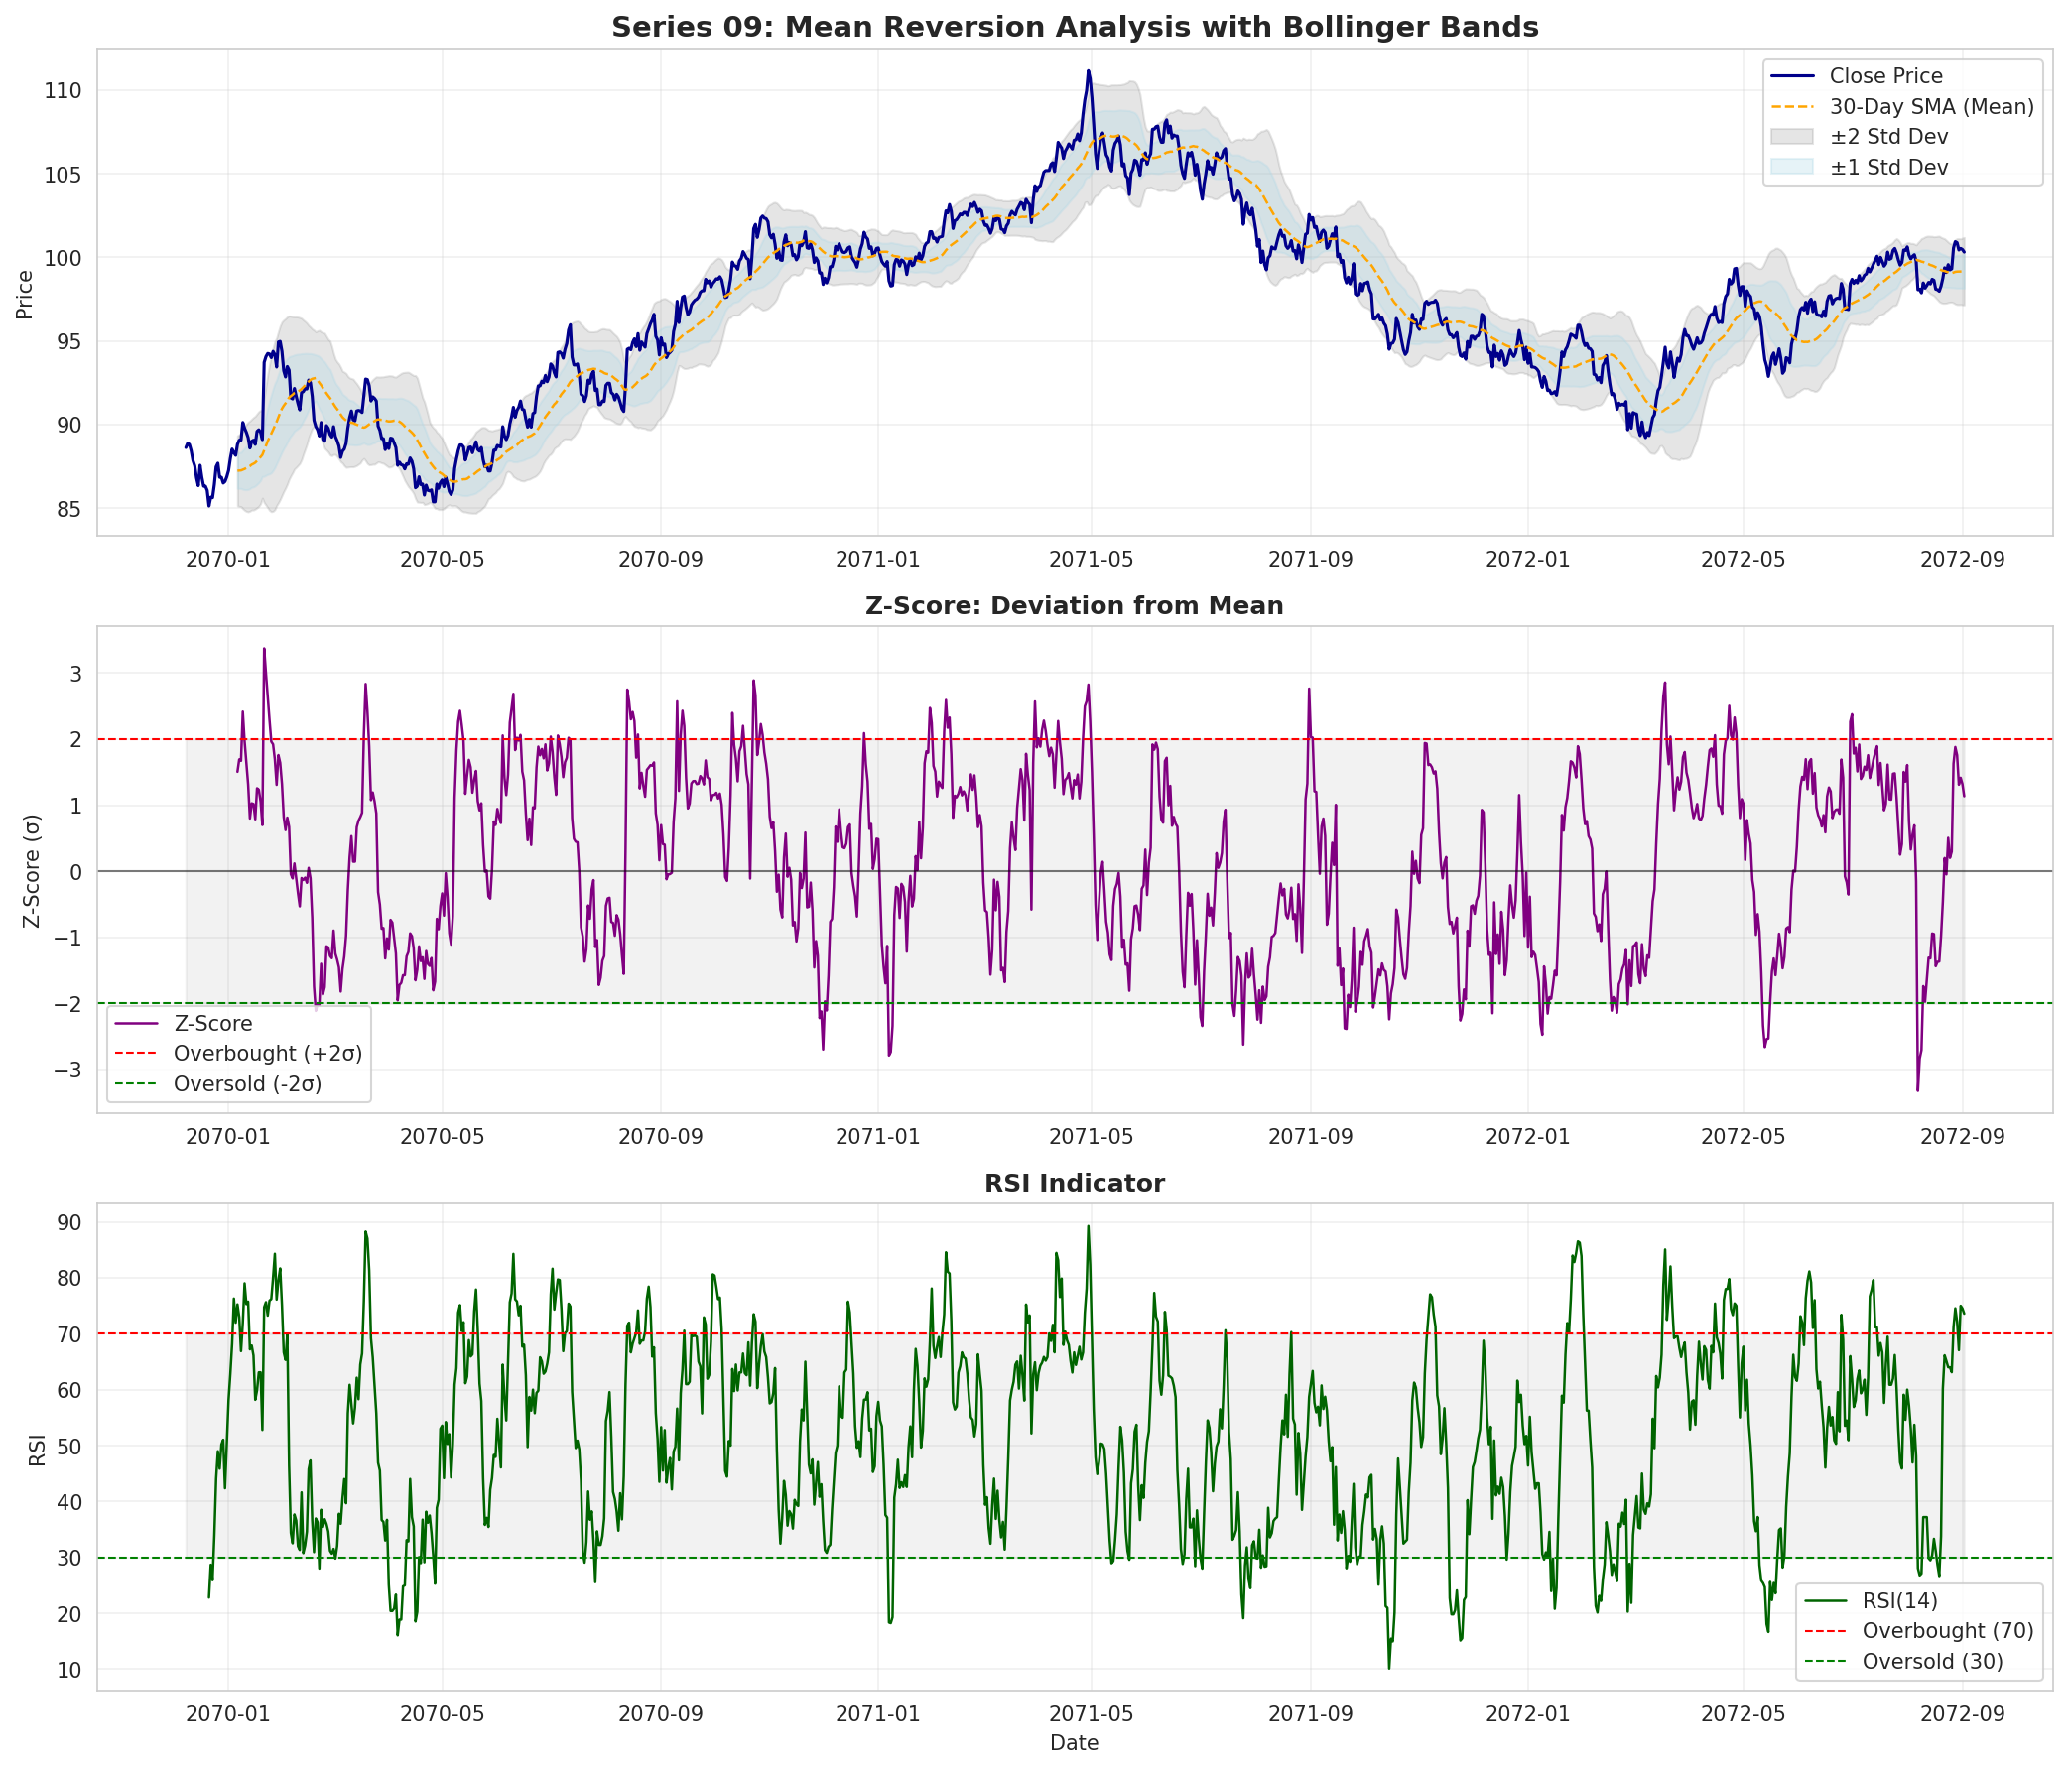
Strategy Definition & Data Analysis (1)
Xue Yudan
For the range-bound market, which exhibiting oscillating price behavior with reversion on statistical mean, we decided to used MEAN-REVERSION STRATEGY with Z-score methodology.
This strategy can be used where extreme deviations from historical norms tend to be correct over time.
With the price remaining within one standard deviation 41.71% of the time, the asset shows favorable range-bound characteristics for mean-reversion strategies.
Notes:
SLIDE 1上: SCRIPT
Strategy 3 is a Z-score mean-reversion strategy on Series 09. We measure how far price is from its 30-day moving average and, when it moves far from this mean, we bet on a partial reversal rather than a continuation.
SLIDE 1下: SCRIPT（± PLUS MINUS, σ SIGMA）
The chart shows price with a 30-day average and ±1, ±2σ bands. Price is inside the ±1σ band 41.71% of days, confirming range-bound behaviour.

Slide 19
Data Analysis (2)
Xue Yudan
The asset demonstrates 39 oversold events where Z-score falls below -2 and 69 overbought events where Z-score exceeds +2, providing approximately 11 trading signals per year.
The mean-reversion correlation of -0.049 between current Z-score and future 5-day returns confirms that extreme deviations tend to reverse.
Notes:
This Z-score series uses +2 as overbought and –2 as oversold. We record 39 oversold and 69 overbought events, around 11 signals per year. With mean 0.179 and standard deviation 1.338, Z below –2 is a genuine statistical extreme, not everyday noise.

Slide 20
Data Analysis (3)
Xue Yudan
The asset demonstrates 39 oversold events where Z-score falls below -2 and 69 overbought events where Z-score exceeds +2, providing approximately 11 trading signals per year.
The mean-reversion correlation of -0.049 between current Z-score and future 5-day returns confirms that extreme deviations tend to reverse.
Notes:
To improve signal quality, we add RSI 14 as a second filter. On this chart, 30 is oversold and 70 is overbought. We only go long when Z-score is at or below minus two and RSI is below 30, so both price deviation and momentum confirm an oversold setup.

Slide 21
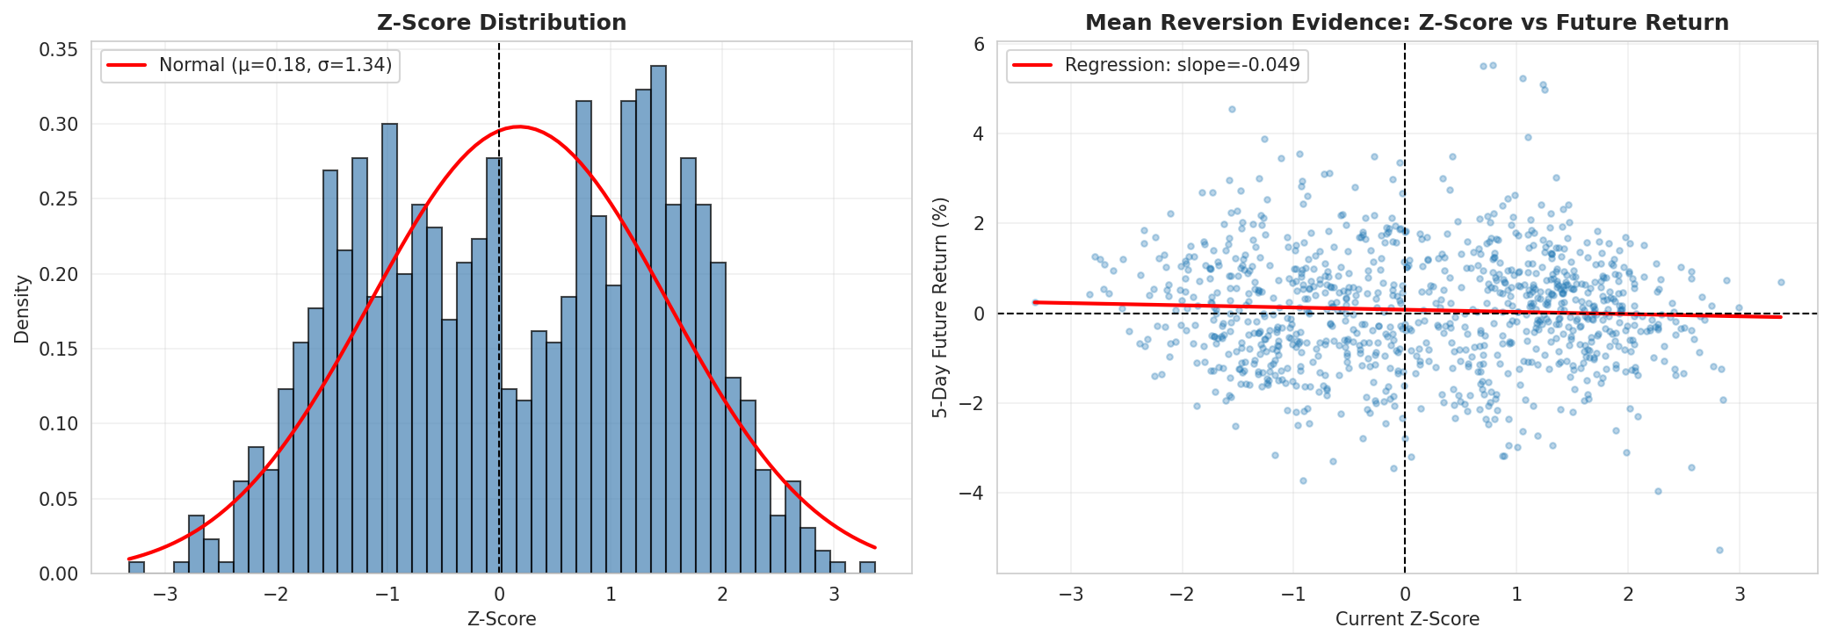
Data Analysis (4)
Xue Yudan
The Z-score distribution shows a near-zero mean of 0.179 with moderate standard deviation of 1.338, indicating price fluctuations centered around the moving average.
Notes:
This slide links current Z-scores to 5-day future returns: most returns cluster around zero, and the regression line in the scatter plot has a small negative slope, so high Z-scores are followed by lower returns and low Z-scores by higher returns.

Slide 22
Technical Specification
Xue Yudan
class MeanReversionStrategy(bt.Strategy):
params = (
('mean_period', 30), # Mean calculation period
('entry_threshold', 2.0), # Z-score entry threshold
('exit_threshold', 0.5), # Z-score exit threshold
('rsi_period', 14), # RSI confirmation period
('max_holding_days', 20), # Maximum position duration
('stake_pct', 0.15), # Position size percentage
('series_index', 8), # Series 09 (0-based index)
)
def __init__(self):
self.mean_price = bt.indicators.SMA(self.data.close, period=self.params.mean_period)
self.std_dev = bt.indicators.StdDev(self.data.close, period=self.params.mean_period)
self.rsi = bt.indicators.RSI(self.data.close, period=self.params.rsi_period)
def next(self):
z_score = (self.data.close[0] - self.mean_price[0]) / self.std_dev[0]
# Entry: Z-score <= -2.0 and RSI <= 30
if not self.position and z_score <= -2.0 and self.rsi[0] <= 30:
size = self.calculate_position_size()
self.buy(size=size)
# Exit: Z-score >= 0.5 or risk management triggers
elif self.position:
if z_score >= 0.5 or self.check_risk_exits():
self.sell(size=self.position.size)
The strategy enters when Z-score falls below -2.0 with RSI confirmation below 30 and exits when Z-score rises above 0.5 or risk management trigger activates.
Notes:
This slide shows the Backtrader code. In init we set up the 30-day mean, 30-day standard deviation and RSI(14). In next we enter long with 15% of capital when Z ≤ –2 and RSI ≤ 30, and exit if Z > 0.5, 5% stop-loss, 4% take-profit, or 20-day limit.

Slide 23
Xue Yudan
PTO- Data splitting and optimization framework
Train–test split: Days 1–700 for optimisation, Days 701–1000 for out-of-sample test.
Careful parameter tuning to balance signal sensitivity and false signals in mean-reversion.
PTO- Overfitting prevention measures
Conservative entry: Z = -2.0 picks statistically rare, genuinely oversold extremes → fewer false signals.
Realistic exit: Z = +0.5 locks in profit on partial mean-reversion, without waiting for full return to the mean.
Stable yet responsive window: 30-day mean/STD window offers a good balance between stability and reactivity.
Independent confirmation: RSI(14) adds a separate momentum check to confirm oversold conditions.
Disciplined risk control: Max 20-day holding stops capital being stuck in trades that never revert.
Moderate risk exposure: 15% position size keeps sizing conservative for a contrarian strategy.
Notes:
We use Days 1–700 for optimization and Days 701–1000 only for out-of-sample testing, so we do not tune on the test data and reduce overfitting. We want parameters not too loose, to avoid many false signals, and not too tight, so we do not miss good trades. The final setting is entry Z = –2.0, exit Z = +0.5, 30-day window, RSI(14), 20-day max holding, 15% size.

Slide 24
Xue Yudan
PTO- Parameter optimization approach
We used a grid search to test many different parameter combinations for the strategy.
Mean / StdDev window (20–40 days): Chosen to look at a long enough price history to be meaningful, but still react fairly quickly to new moves.
Entry Z-score (1.5–2.5): Higher thresholds give fewer but stronger signals; lower ones give more frequent but noisier trades, so we searched this middle range.
Exit Z-score (0.0–1.0): Targets a return back toward the mean, while trying not to exit too early before the move is complete.
RSI window (10–20 days): Used as a confirmation filter for overbought/oversold conditions over a short to medium horizon.
Max holding period (10–30 days): Limits how long we keep trades that have not reverted, so capital is not stuck in bad positions.
Position size (10–20% of capital): Keeps trade sizes conservative, which is important for a contrarian, potentially risky strategy.
Notes:
We run a grid search on the training set, varying the mean and standard-deviation window 20–40 days, entry Z 1.5–2.5, exit Z 0–1, RSI 10–20 days, max holding 10–30 days, and position size 10–20 percent, aiming for high Sharpe and dropping unstable, low-trade sets.

Slide 25
Xue Yudan
PTO- Parameter selection rationale
Safeguards Against Overfitting in Mean-Reversion Strategies
Minimum Trade Count Filter
Multi-Period Validation
Drawdown Constraints
Strict Out-of-Sample Testing
Exclude parameter sets with too few trades to ensure performance is statistically reliable.
Check parameters across multiple subperiods to confirm robustness, not just one favorable regime.
Reject combinations whose max drawdown is too large to protect capital.
Reserve Days 701–1000 solely for final testing, never using them in optimization.
Notes:
We also use safeguards against overfitting. We drop parameter sets with few trades, test each candidate across sub-periods in Days 1 to 700, and reject any with large drawdowns. Only after these checks do we run the final parameters once on Days 701 to 1000 as a “final exam”

Slide 26
Xue Yudan
PTO- Final parameter configuration
Parameter | Value | Justification
Entry Threshold (Z-score) | -2.0 | Statistical extreme (2.3% probability)
Exit Threshold (Z-score) | +0.5 | Captures partial reversion, avoids greed
Mean Period | 30 days | Monthly statistical window
RSI Period | 14 days | Standard momentum confirmation
RSI Oversold | 30 | Conservative oversold threshold
Maximum Holding | 20 days | Limits capital lock-up risk
Position Size | 15% | Conservative contrarian sizing
Stop-Loss | 5% | Tight risk control for failed reversions
Take-Profit | 4% | Modest target aligned with reversion magnitude
Metric | Value
Test Return | +0.27%
Annualized Return | +0.23%
Annualized Sharpe Ratio | 0.396
Maximum Drawdown | -0.37%
Activity Level | 12.7%
Win Rate | 6.7%
Trading Days | 300
Table 3.1: Out-of-Sample Performance (Days 701-1000)
Out-of-sample Sharpe ratio 0.396 → positive risk-adjusted performance
Test return +0.27% with very small maximum drawdown 0.37%
Activity level 12.7% → highly selective entries from conservative Z-score
Win rate 6.7% (vs 30% in training) → weaker mean reversion, need conservative parameters and strict risk control
Notes:
Out of sample, Strategy 3 earns +0.27% test return with Sharpe approximately 0.4%. Max drawdown is only 0.37%. It trades on 12.7% of days, with 6.7%-win rate, yet still delivers a modest but positive risk-adjusted performance.

Slide 27
Xue Yudan
Future Plan-ADX regime filter for S3
• S3 mean-reversion suffers large losses in strong
• Next step: add an ADX regime filter – only trade when ADX is below a threshold.
• Roadmap: baseline tests on Data 1, then train/validate the filter on Data 2 with a train/OOS split.
Is ADX < Threshold (e.g. 20)?
Yes → Run S3 Mean-Reversion Trades
Market Data (Price + ADX)
No → Skip S3 Trades (Avoid Strong Trends)
Notes:
Strategy 3 is counter-trend, so strong one-way trends can still cause losses. Next we add an ADX regime filter: only trade S3 when ADX is low, for example, when below 20, and skip trades when ADX is high. We will test this on Data 1 and Data 2.

Slide 28
Wong Haw & Zhao Yixuan
Content
Strategy Definition
Data Analysis
Mathematical Framework
Technical Implementation
Preliminary Testing & Optimization
Out-of-Sample Result
Weight Allocation
Risk Management
Future Plan
Combined Strategy:
Conditional Value at Risk
(CVaR)
Series 04&05&09

Slide 29
Combined Strategy Definition
Wong Haw
Combined framework : The three strategies are merged into one system that uses CVaR optimization to allocate weights dynamically.
Rebalancing schedule and limits : Every 20 trading days the system recalculates weights using the past 60 days of returns, with each strategy constrained to at least 10% and at most 70% of the portfolio.
Independent strategy execution : Each strategy trades only in its own market series and keeps its own entry and exit rules; the optimizer only controls how much capital each strategy receives.
Tail‑risk minimization : The optimizer minimizes expected losses in the worst 5% of outcomes by computing portfolio CVaR at the 95% confidence level and adjusting weights within the 10–70% bounds, giving better downside protection than mean‑variance methods while aiming to keep returns competitive.

Slide 30
Data Analysis
Wong Haw
The Portfolio Constituents: This combined strategy relies on the distinct characteristics of the underlying asset series to achieve diversification.
Input 1: Series 04 (Trend Following)
  Role: Capitalizes on momentum.
  Constraint: Minimum 10% allocation maintained even during range-bound periods to capture breakout volatility.
Input 2: Series 05 (Buy & Hold)
  Role: Provides long-term positive drift and stability.
  Behavior: Dominates allocation (up to 70%) during sustained trending markets due to superior risk-adjusted returns.
Input 3: Series 09 (Mean Reversion)
  Role: Counter-trend component.
  Behavior: Gained prominence (up to 67.8%) during range-bound volatility when trend strategies underperformed.

Slide 31
Why CVaR?
Wong Haw
Fundamental Problem: Simple aggregation of strategies was rejected due to high correlation risk
Alternative 1: Mean-Variance Optimization (MVO)
Flawed because it penalizes profitable upside volatility equally to downside risk.
Alternative 2 : Hierarchical Risk Parity (HRP)
An advanced ML clustering method, but too complex to justify for a small, three-strategy portfolio
Solution : Conditional Value at Risk (CVaR)
Chosen. Because it isolates Tail Risk
(worst 5% of outcomes).
Benefit:
Directly targets the minimization of Maximum Drawdown, optimizing our key performance metric (PD Ratio).
Notes:
Mean-Variance (MV) optimization aims to minimize total portfolio variance. It penalizing both upside (favorable) and downside (unfavorable) volatility equally. This approach assumes returns are normally distributed, this is the reason why it often fails to capture the "fat-tailed" distributions (i.e., extreme events) in financial markets.
For HRP, this is a modern, machine-learning-based method that first clusters correlated strategies. This method will cluster assets by similarity (e.g., equities together, bonds together), form a tree, allocate risk across major clusters, then split within clusters. This will prevent overweighting many highly correlated assets.
CvaR as a risk measure, is better than variance because it focuses on downside tail risk, seeking to minimize the expected loss in the worst-case scenario.

Slide 32
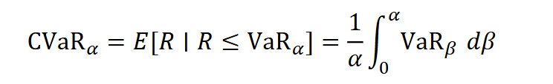
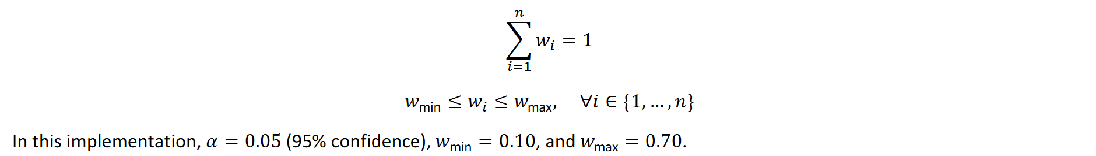
Mathematical Framework
Wong Haw
And also subject to:

Slide 33
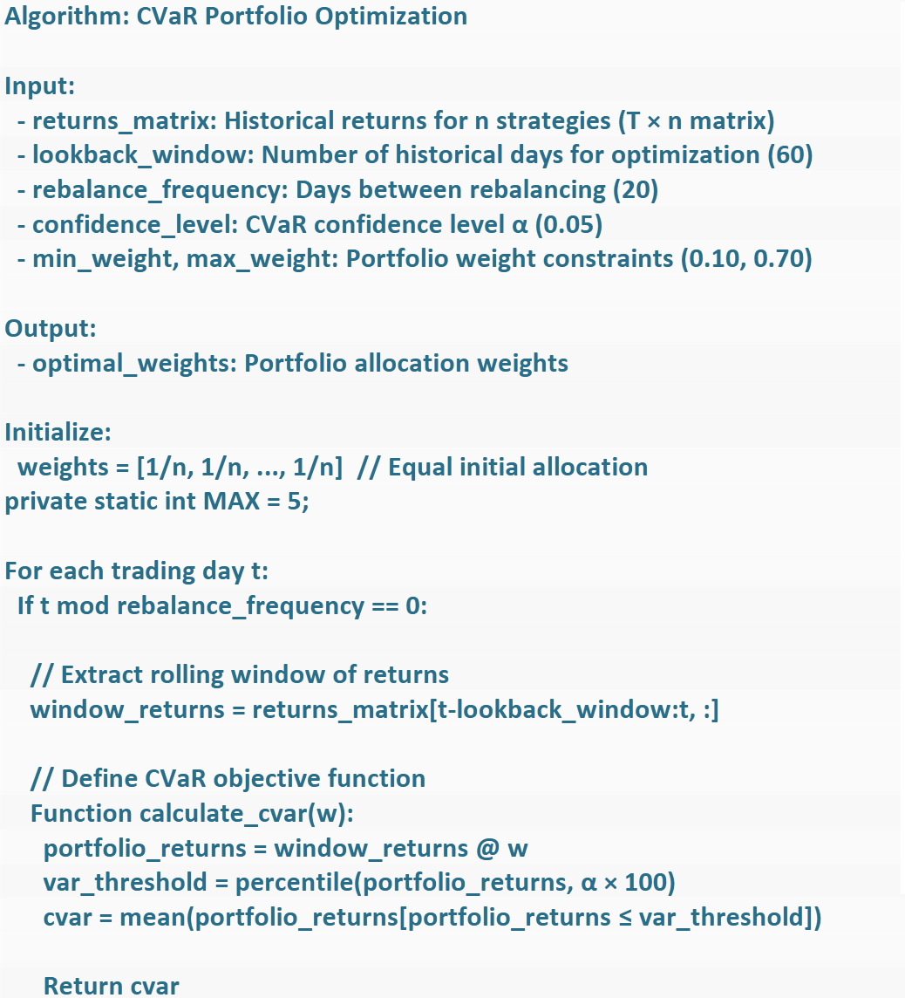
Technical Implementation
Zhao Yixuan
Execution Logic (Pseudocode Summary):
Initialize: Start with equal weights (1/3 each).
Lookback Window: Analyze the last 60 trading days of returns.
Rebalance Frequency: Every 20 trading days.
Process:
  Extract return window.
  Calculate portfolio CVaR at 95% confidence.
  Optimize weights to minimize this specific tail risk.
  Apply constraints (Min 10%, Max 70%).
  Reallocate capital.
Notes:
Thanks to my teammates for their presentations. I'll introduce the remaining part.
At a high level, the portfolio starts with one million pounds and an equal one-third allocation to each strategy. Every twenty trading days, we take the last sixty days of realised returns, build a rolling window, and send this into the CVaR optimiser, which updates the weights within the 10%-70% bounds.

Slide 34
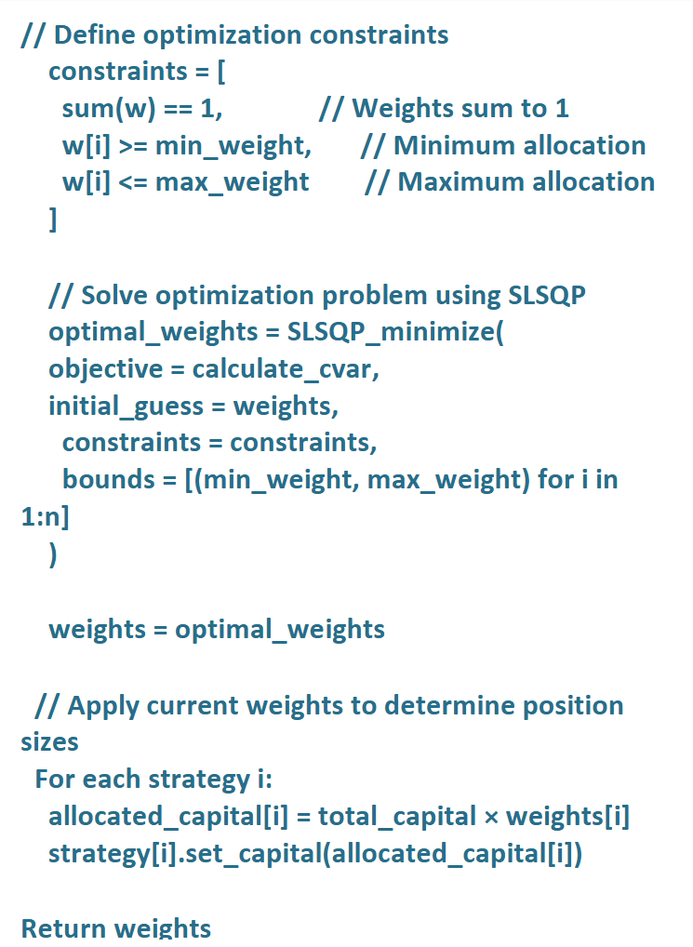
Technical Implementation
Zhao Yixuan
Sequential Least Squares Programming (SLSQP):
Algorithm: Gradient-based iterative method used to solve the constrained optimization problem
Implementation: Utilizes ‘scipy.optimize.minimize’ with method='SLSQP' for automatic gradient estimation
Notes:
To solve the optimisation problem, we use SciPy's SLSQP solver. It finds the portfolio weights that minimise 95% CVaR over the last sixty trading days, subject to the weights summing to one and each weight staying between ten and seventy percent.

Slide 35
Preliminary Testing & Optimization
Zhao Yixuan
CVaR vs. Mean-Variance (MV) Optimization
MV Limitation: Penalizes "upside" volatility equally to downside risk, assuming normal distribution.
CVaR Advantage: Asymmetric risk measure; strictly targets the "left tail" (extreme losses) which aligns better with loss avoidance
Parameter Optimization Framework
Lookback Period: 60 days—chosen to balance responsiveness with statistical significance.
Constraints: 10% min / 70% max—prevents over-concentration while allowing optimization flexibility.
Testing Method: Tested on Data 1 (Development) before Out-of-Sample validation on Data 1 (Days 701-1000).
Notes:
Then move on to the PTO part. Before fixing the design of the combined strategy, we ran a series of tests on the CVaR optimiser itself.
On the training sample, we tried different lookback windows and rebalance frequencies and evaluated them using out-of-sample Sharpe ratio, maximum drawdown, and the stability of the weight paths.
Based on these tests, we selected a 60-day lookback, a 20-day rebalance interval, and 10–70% weight bounds as the most robust configuration: it kept drawdowns low, avoided extreme allocations, and did not over-react to short-term noise.

Slide 36
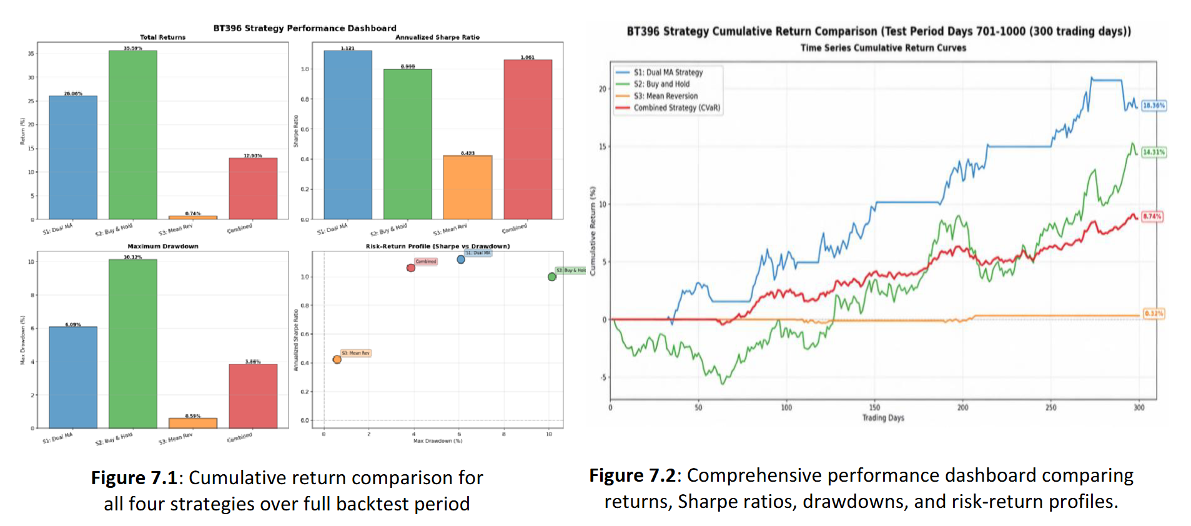
Out-of-sample Result
Zhao Yixuan
Visual Evidence: The red line (Combined Strategy) in Figure 7.1 demonstrates a smooth equity curve, avoiding the deep drawdowns seen in individual strategies
Notes:
For the result, The chart on the left compares cumulative returns for the three individual strategies and the combined portfolio - the combined line is smoother and avoids the deeper drawdowns seen in the single strategies. The panel on the right summarises performance and drawdowns, and again we see that the CVaR portfolio delivers higher risk-adjusted returns with much tighter downside risk than any one strategy on its own.

Slide 37
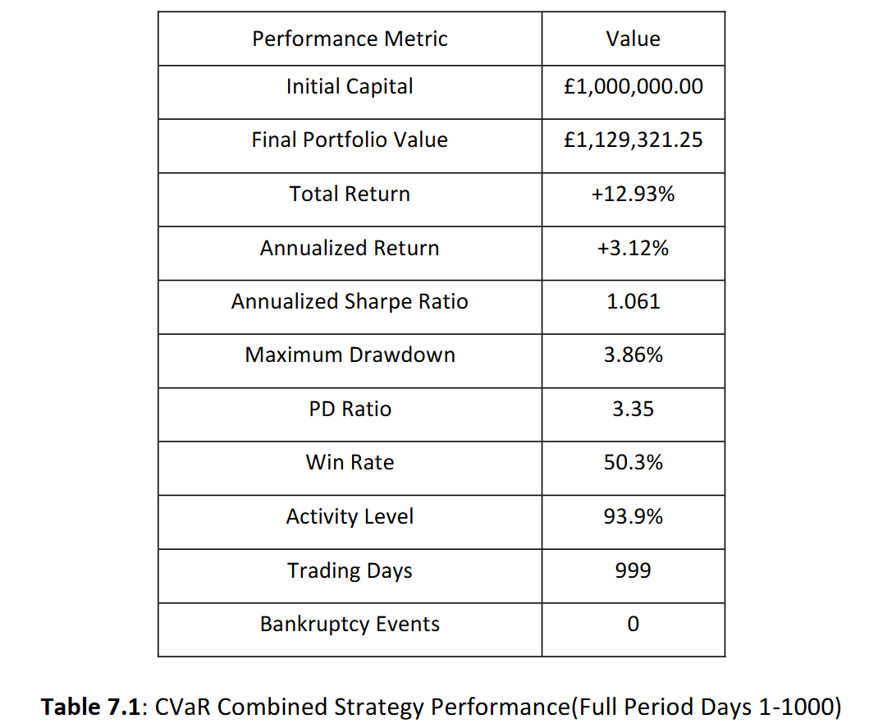
Out-of-sample Result
Zhao Yixuan
Superior Risk-Adjusted Returns: Sharpe Ratio of 1.061 outperforms the equal-weight benchmark.
Tail Risk Control: Max drawdown limited to 3.86%, validating the effectiveness of CVaR.
Consistency: A PD Ratio (Return-to-Drawdown) of 3.35 indicates strong recovery capabilities.
High profitability : A 12.93% total return over the testing period.
Highly active management : the 93.9% activity level indicates consistent management involvement across all three assets series during the testing period.
Notes:
Numerically, the combined strategy delivers a total return of about 12.9%, with a maximum drawdown is kept to 3.86%, giving a PD ratio of 3.35. And zero bankruptcy events in the backtest, which shows that tail-risk control is working as intended.

Slide 38
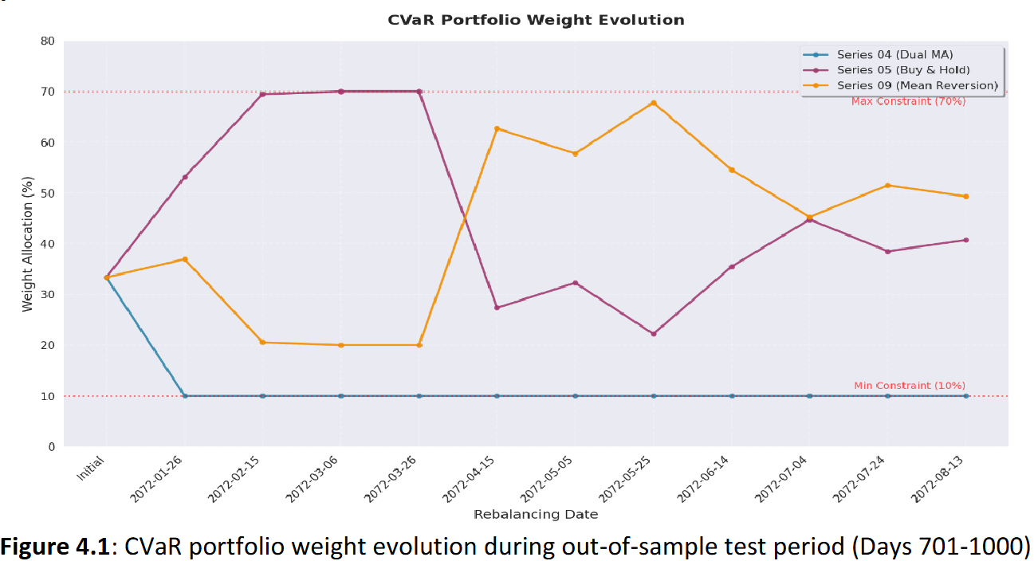
Weight Allocation
Zhao Yixuan
Jan - Mar 2072 (Trending): Series 05 (Buy & Hold) dominated with 70% allocation.
Apr - Aug 2072 (Ranging): Series 09 (Mean Reversion) peaked at 67.8% allocation as the market shifted to oscillation.
Tail Risk Check: Series 04 (Dual MA) stayed at the 10% minimum due to higher relative tail risk contribution.
Notes:
The weight plot of our strategy shows how the optimiser adapts to market regimes. In trending periods, the buy-and-hold leg on Series 05 is pushed towards 70%, while in range-bound phases the mean-reversion leg on Series 09 rises above 60%, and the dual-MA leg often stays near the 10% floor.

Slide 39
Risk Management Framework-Strategy level
Zhao Yixuan
Individual Trade Risk Management
Stop-Loss Protocols:
  S1: 10% Stop ; 20% Target
  S2: rigorous initial asset selection
  S3: 5% Stop ; 4% Target
Position Sizing: Fixed percentage of allocated capital, preventing single-trade over-exposure.
Bankruptcy Risk Mitigation
Stop-Loss Enforcement: S1 10%, S3 5% → cap per-trade losses..
Position Sizing Discipline: Fixed % of strategy capital (25%, 100%, 15%) → avoid oversized positions.
Diversification Constraints: 10–70% weights → prevent concentration & cross-strategy failure.
Notes:
At the strategy level, we control risk with simple rules. Trend-following uses a 10% stop-loss and 20% target, mean-reversion uses a 5% stop-loss, 4% take-profit and a 20-day maximum holding period, and position sizes are fixed as 25%, 100%, and 15% of allocated capital so that no single trade can dominate risk inside a strategy.

Slide 40
Risk Management Framework-Portfolio level
Zhao Yixuan
Dynamic Weight Rebalancing:
Automatic Adaptation: Weights recalculate every 20 days based on rolling 60-day data.
Performance Filtering: The system automatically reduces weights toward the 10% minimum for strategies showing deteriorating Sharpe ratios or high CVaR.
Result: Eliminates behavioral bias. No manual intervention required to cut exposure to failing strategies.
Bankruptcy Risk Mitigation
Tail-Risk Focus: Worst 5% losses targeted; capital shifts from high-drawdown strategies.
Proactive Shield: Insolvency risks addressed before extreme losses emerge.
Minimal Bankruptcy Risk: Max drawdown 3.86%; Sharpe 1.061 → negligible default probability.
Layered Defense: Diversification, sizing limits, CVaR control, auto-rebalancing.
Notes:
At the portfolio level, the CVaR optimiser automatically cuts exposure to strategies that contribute more tail risk, gradually pushing them towards the 10% minimum instead of letting one component dominate the portfolio. We also perform pre-trade cash checks and monitor total net worth so the system cannot use hidden leverage, and it would liquidate before equity becomes negative; in our tests this keeps maximum drawdown at 3.86% with zero bankruptcy events, making full capital loss very unlikely.

Slide 41
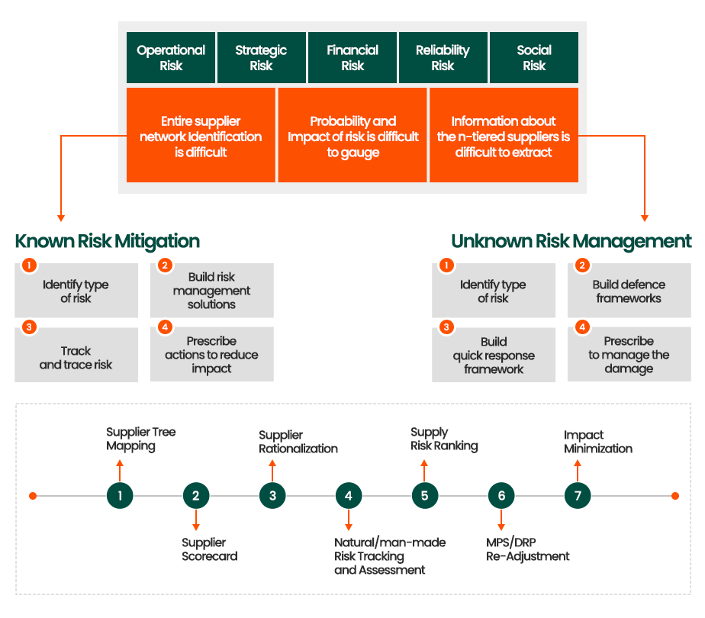
Strategy & Cross-Series Risk Management
Zhao Yixuan
Correlation & Regime:
Diversification: Strategies operate on different underlying series, naturally lowering correlation.
Optimization: CVaR process systematically favours combinations with reduced joint tail risk.
Regime Shift: Automatically rotates capital from Trending (S1/S2) to Ranging (S3) strategies based on recent data.
Notes:
Because the three strategies trade different series and styles, their returns are only partly correlated. The CVaR objective therefore favours combinations with lower joint tail risk and naturally shifts weight between three Strategies as regimes change.

Slide 42
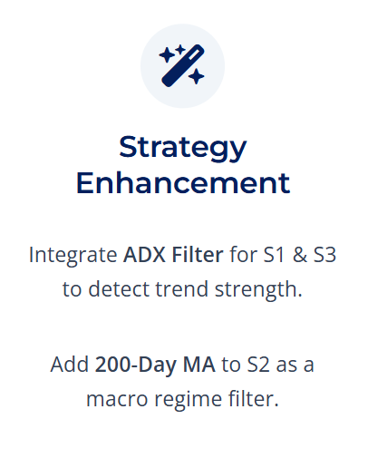
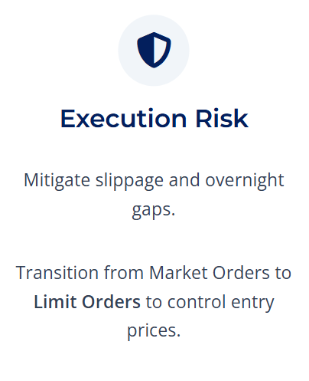
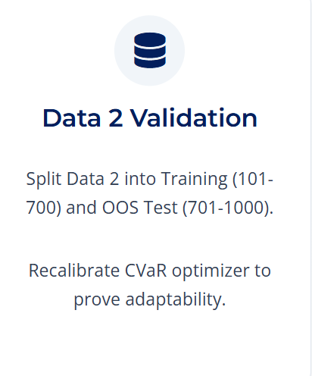
Future Plans
Zhao Yixuan
Notes:
Looking ahead, we plan to feed upgraded versions of the three base strategies into the same CVaR layer, using regime filters such as ADX (same as the individual strategies) and a 200-day moving average so each engine trades only in its favourable conditions. On the execution side, we will also test using limit orders instead of pure market orders to reduce slippage and gap risk and then re-calibrate the combined system on Data 2 with a fresh train-test split.

Slide 43
Thank You For Listening !

